Slide 1
LECTURE 1.1: PROGRAMMING FUNDAMENTALS
Abdul Karim Shahid
(akarim@cuilahore.edu.pk)

Slide 2
OUTLINE
What are computers?
What is software?
What is programming?
Why programming?
Basic Concepts
  Algorithms
    Pseudo code
    Flowcharts
    Decision Tables
Understanding the steps to write/run programs
Low- and high-level programming
First C program
Slide <number>

Slide 3
WHAT IS A COMPUTER?
Computer
  Device capable of performing computations and making logical decisions
  Computers process data under the control of sets of instructions called computer programs
Hardware
  Various devices comprising a computer
  Keyboard, screen, mouse, disks, memory, CD-ROM, and processing units
Software
  Programs that run on a computer
    System Software
    Application Software
Slide <number>
Notes:
Points to Ponder-> Several billion additions/sec VS Humans.
Super computers can perform thousands of trillions (quadrillions) of instructions/second. Eg: 1 Quadrillion-instruction/second computer can perform more than 100,000 calculations/sec for every person on the planet.

Slide 4
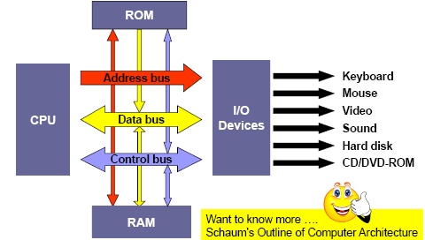
WHAT’S INSIDE A COMPUTER

Slide 5
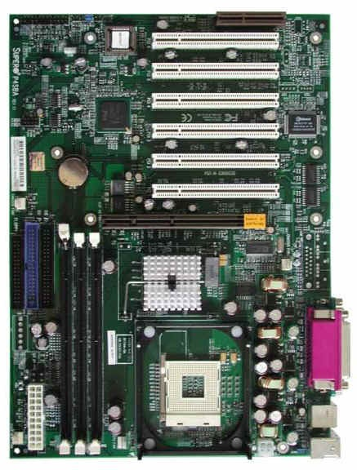

Slide 6
COMPUTER!
Tablet
Palmtop
Laptop
Desktop
And many more!!!

Slide 7
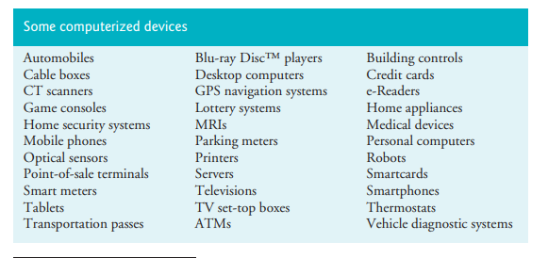
COMPUTER!
Slide <number>

Slide 8
SYSTEM VS. APPLICATION
The similarity
  Both software
The distinction
  Scope of users

Slide 9
SYSTEM SOFTWARE!
Windows—A Proprietary Operating System
Linux—An Open-Source Operating System
Apple’s macOS and Apple’s iOS for iPhone® and iPad® Devices
Google’s Android

Slide 10
APPLICATION SOFTWARE!
MS Office
Internet Explorer
Real Player
…

Slide 11
HOW DIFFERENT?
System software (OS)
  Serving all users
  I.e., everyone needs it
  Known functionalities
Application software (MS Office)
  Serving those users who need the specific functions
  I.e., not everyone needs it
  User-specific functionalities

Slide 12
WHATEVER APPLICATION YOU CAN THINK OF!

Slide 13
HOW APPLICATIONS ARE CREATED

Slide 14
PROGRAMMER’S SECRET LIFE
Terminology
  Program composition
  Programming languages
  Programming language classification

Slide 15
TERMINOLOGY
Application
  Short for application software
  Short for application program
Programme (noun)
  Specific, countable
Software
  General, not countable
  Usually meant a collection of programs

Slide 16
3P’S
Programme
  A set of rules for your computers to follow in order to achieve a goal
Programmer
  A person who produces the program
  A person who makes a living from producing programs
Programming language
  A way for a programmer to write about the set of rules

Slide 17
AS IF
Computers are creatures from outer space
They speak strange languages
Programmers study their languages
Therefore, they are able to tell the computers what to do

Slide 18
THE 3P RELATIONSHIP
Programmers write programs
using programming languages.

Slide 19
IN LITERATURE
Ashfaq Ahmad writes Zavia using Uurdu.

Slide 20
IN COMPUTER SCIENCE
Ali writes Hello World using C.

Slide 21
OR
You write your homepage using HTML.

Slide 22
IT IS A PROCESS OF CREATIVITY.

Slide 23
WRITING VS. PROGRAMMING
Setting the theme
Structuring
Writing
Proof-reading
Defining the problem
Planning the solution
Coding the program
Testing the program
Documenting the program
  commenting

Slide 24
WHAT IS COMPUTER PROGRAMMING?
A way to solve problems using a computer
How?
  Through a sequence of very clear and defined steps that aim to solve the problem -> this is called an algorithm
Algorithms are not only used for computer programming, they are a general concept for problem solving
Slide <number>

Slide 25
DEFINING THE PROBLEM
Input
Problem to be solved
Output

Slide 26
PLANNING THE SOLUTION
Algorithms
  Ways of solving the same problem
  Some fast; some slow
  Some long; some short
Formats
  Pseudo code
  Flow chart
  Decision Tables

Slide 27
ALGORITHM
The order of the actions in an algorithm is important
  Example: algorithm to go to work every morning
    Get out of bed;
    Take a bath;
    Get dressed;
    Eat breakfast;
    Take the bus to work.
If I carry out the same actions in a different order
    Get out of bed;
    Get dressed;
    Take a bath;
    Eat breakfast;
    Take the bus to work.
Then, I will still get to work, however soaking wet
So order is important
Slide <number>

Slide 28
PSEUDO CODE , FLOWCHART AND DECISION TABLE
However, programming languages can be complex for students that are starting to learn how to program
The focus in programming fundamentals is also to learn how to solve a problem through a computer program
Therefore, we will introduce the use of pseudo codes and flowcharts to describe algorithms (solutions of the proposed problems) and after that, we will learn how to translate them to a programming language, like C.
Decision Tables are used to define clearly and concisely the word statement of a problem in a tabular form
Slide <number>

Slide 29
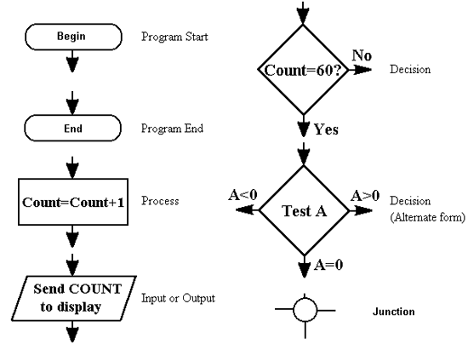
FLOW CHART SYMBOLS
Flow Lines
Connectors
Flow Lines
Connectors

Slide 30
PSEUDO CODE
Example: The following set of instructions forms a detailed algorithm in pseudo-code for calculating the payment of person.
  Begin
  Input the three values into the variables Name, Hours, Rate.
  Calculate Pay = Hours * Rate.
  Display Name and Pay.
  End
Slide <number>

Slide 31
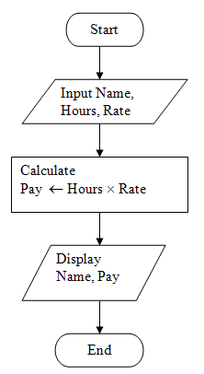
FLOWCHARTS
Slide <number>

Slide 32
DECISION TABLES
Taking Decision on Discount | Decision Rule Numbers
 | R1 | R2 | R3 | R4 | R5 | R6 | R7 | R8
Condition Statements
Less than 50 units ordered | Y | Y | Y | Y | N | N | N | N
Cash on Delivery | Y | Y | N | N | Y | Y | N | N
Wholesale Outlet | Y | N | Y | N | Y | N | Y | N
Actions Taken
Discount Rate 0% |  |  |  | X
Discount Rate 2% |  | X | X |  |  |  |  | X
Discount Rate 4% | X |  |  |  |  | X | X
Discount Rate 6% |  |  |  |  | X
Slide <number>

Slide 33
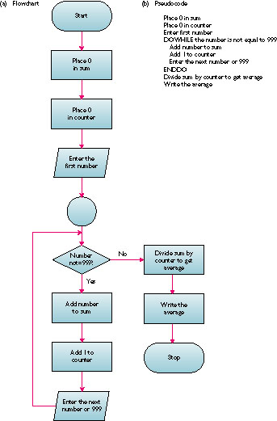
FLOW CHART ANOTHER EXAMPLE
(b) Pseudo code
Place 0 in sum
Place 0 in counter
Enter first number
DOWHILE the number is not equal to 999
Add number to sum
Add 1 to counter
Enter next number or 999
ENDDO
Divide sum by counter to get average
Write the average
Accept series of numbers and display the average

Slide 34
CODING THE PROGRAM
Sentence by sentence, word by word
Detailed description in the chosen language
Polly Huang, NTU EE

Slide 35
TESTING THE PROGRAM
Translation – compiler
  Translates from source module into object module
  Detects syntax errors
Link – linkage editor (linker)
  Combines object module with libraries to create load module
  Finds undefined external references (run-time errors)
Debugging
  Run using data that tests all statements
  Logic errors
Polly Huang, NTU EE

Slide 36
DISTINCTION
Source code
  Your creation
Object modules
  Machine code of your creation
Load modules
  Machine code of pre-installed functions
Executable programs
  Combination of your and pre-installed machine code
Polly Huang, NTU EE

Slide 37
DOCUMENTING THE PROGRAM
Comments within source code
In plain English
Convenient for
  The programmer him/herself who needs to read the program later
  Somebody else who needs to read the program
Polly Huang, NTU EE

Slide 38
C PROGRAM DEVELOPMENT ENVIRONMENT
Editor
Disk
Program is created in the editor and stored on disk.
Phases of C Programs:
Edit
Preprocessor
Compile
Link
Load
Execute
Preprocessor
Disk
Preprocessor program processes the code.
Compiler
Disk
Compiler creates object code and stores it on disk.
Linker
Disk
Linker links the object code with the libraries
Loader
Physical Memory
Loader puts program in memory.
Disk
CPU takes each instruction and executes it, possibly storing new data values as the program executes.
Physical Memory
CPU
Slide <number>
Slide <number>

Slide 39
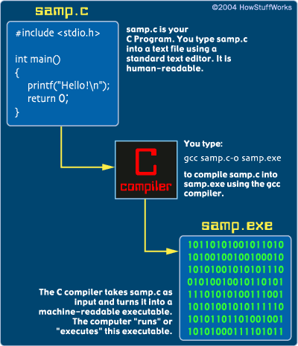
Slide <number>

Slide 40
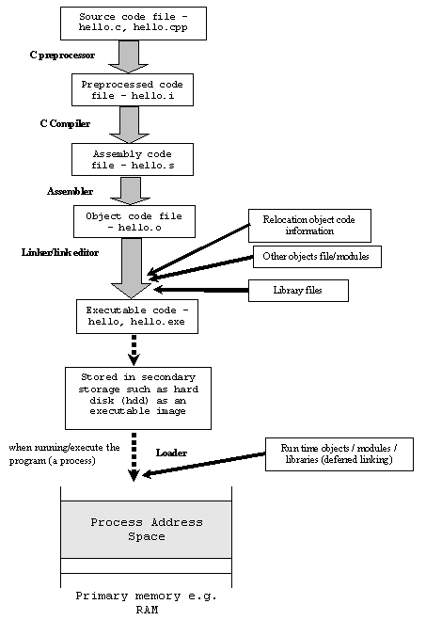
Slide <number>

Slide 41
COMPILERS VS. INTERPRETERS
Compilers
  Compile several machine instructions into short sequences to simulate the activity requested by a single high-level primitive
  Produce a machine-language copy of a program that would be executed later
Slide <number>

Slide 42
COMPILERS VS. INTERPRETERS
Interpreters
  Execute the instructions as they were translated
  An interpreter reads a code statement, converts it to one or more machine language instructions, and then executes those machine language instructions.
  It does this all before moving to the next code statement in the program.
  Each time the source program runs, the interpreter translates and executes it, statement by statement.
Slide <number>

Slide 43
QUESTIONS SO FAR?
Polly Huang, NTU EE

Slide 44
NATURAL LANGUAGES
Until now we have used the English language to describe the algorithms
Natural languages like English, Russian, Urdu are not completely formal and many times they are vague or ambiguous
The written algorithms used in computers need to be concise, complete and non-ambiguous, therefore, a formal language is used to describe them
Slide <number>

Slide 45
EXAMPLES
I saw someone on the hill with a telescope.
(
Did you use a telescope to see someone on the hill or did you see someone on the hill holding a telescope?
)
I invited the person with the microphone.
(
This example has two different meanings:
I spoke (using the microphone) to invite the person
I invited the person who (has the microphone).
)
Slide <number>

Slide 46
PROGRAMMING LANGUAGES
Quite a bit of them!
Polly Huang, NTU EE

Slide 47
GENERATIONS OF PROGRAMMING LANGUAGE
Generation | First | Second | Third | Fourth
Code example | 1010101001100010 1001101010000001 1111111110100010 | LDA 34 ADD #1 STO 34 | x = x + 1 | body.top { color : red; font-style : italic }
Language | (LOW) Machine Code | (LOW) Assembly Code | (HIGH) Visual Basic, C, python etc. | (HIGH) SQL, CSS, Haskell etc.
Relation to Object Code (generally) | -- | one to one | one to many | one to many
Slide <number>

Slide 48
1GL or first-generation language was (and still is) machine language or the level of instructions and data that the processor is actually given to work on (which in conventional computers is a string of 0s and 1s).
Slide <number>

Slide 49
2GL or second-generation language is assembler (sometimes called "assembly") language. A typical 2GL instruction looks like this:
ADD 12,8
An assembler converts the assembler language statements into machine language.
Slide <number>

Slide 50
3GL or third-generation language is a "high-level" programming language, such as PL/I, C, orJava. Java language statements look like this:
    public boolean handleEvent (Event evt) {
    switch (evt.id) { case Event.ACTION_EVENT: {
    if ("Try me" .equald(evt.arg)){
A compiler converts the statements of a specific high-level programming language into machine language. (In the case of Java, the output is called bytecode, which is converted into appropriate machine language by a Java virtual machine that runs as part of an operating system platform.) A 3GL language requires a considerable amount of programming knowledge.
Slide <number>

Slide 51
4GL or fourth-generation language is designed to be closer to natural language than a 3GL language. Languages for accessing databases are often described as 4GLs. A 4GL language statement might look like this:
  EXTRACT ALL CUSTOMERS WHERE "PREVIOUS PURCHASES" TOTAL MORE THAN $1000
Slide <number>

Slide 52
5GL or fifth-generation language is programming that uses a visual or graphical development interface to create source language that is usually compiled with a 3GL or 4GL language compiler. Microsoft, Borland, IBM, and other companies make 5GL visual programming products for developing applications in Java, for example. Visual programming allows you to easily envision object-oriented programming class hierarchies and drag icons to assemble program components.
Slide <number>

Slide 53
Machine Language, Assembly Language and High-Level Language
Three types of programming languages
  Machine languages
    Strings of numbers giving machine specific instructions. Programs written in machine language consist of entirely of 1s and 0s
    Example:
        00101010 000000000001 000000000010
        10011001 000000000010 000000000011
  Assembly languages
    English-like abbreviations representing elementary computer operations (translated via assemblers)
    Example:
        LOAD BASEPAY
        ADD OVERPAY
        STORE GROSSPAY
Slide <number>

Slide 54
Machine Language, Assembly Language and High Level Language
  High-level languages
    Codes similar to everyday English
    Use mathematical notations (translated via compilers)
    Example:
      grossPay = basePay + overTimePay
Slide <number>

Slide 55
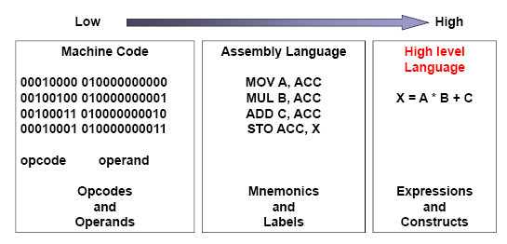
PROGRAMMING LEVELS
Slide <number>

Slide 56
TYPES OF LANGUAGES
Old vs. new
Low level vs. high level
Procedural vs. Object-oriented
Mark-Up vs. programming language
Polly Huang, NTU EE

Slide 57

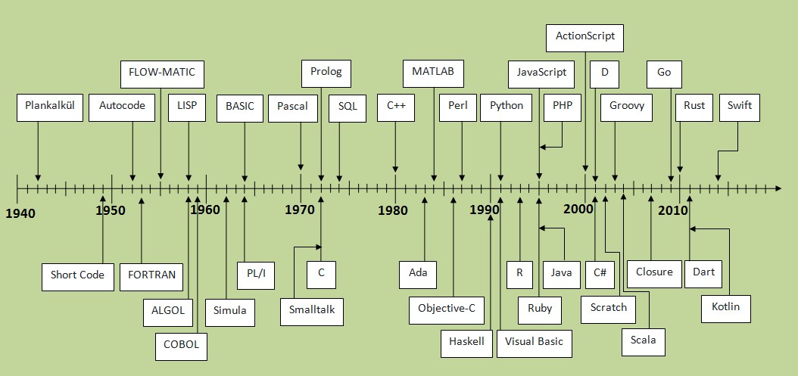
OLD VS NEW
Slide <number>

Slide 58
LOW OR HIGH
Low level
  Close to binary
  Computer dependent
  Ex. Machine Language, Assembly Language
High level
  Close to human readable style
  Computer independent
  Compiler translates from high-level language to machine language
  Ex. All the other languages
Polly Huang, NTU EE

Slide 59
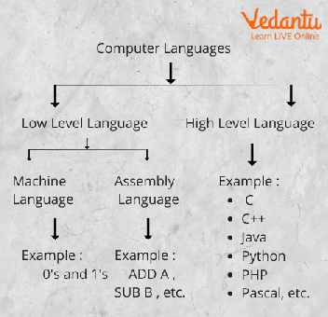
Slide <number>

Slide 60
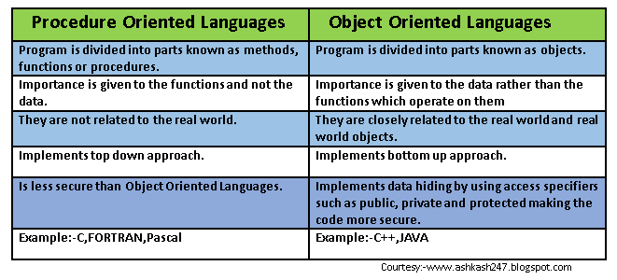
PROCEDURAL VS. OBJECT-ORIENTED
Slide <number>

Slide 61
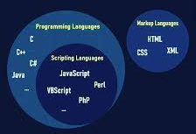
MARK-UP VS. PROGRAMMING LANGUAGE
Slide <number>

Slide 62

MACHINE LANGUAGE
Written in strings of 0 and 1
Only language the computer understands
All other programming languages are translated to machine language
Polly Huang, NTU EE

Slide 63
ASSEMBLY LANGUAGE
Mnemonic codes
Names for memory locations
Assembler translates from Assembly to machine language

Slide 64
FORTRAN
1954
Represent complex mathematical formulas
C/C++ has replaced FORTRAN

Slide 65
COBOL
1959
Business
Large complex data files
Formatted business reports
SQL for example has replaced COBOL

Slide 66
BASIC
1965
Popularity grew with PC popularity (1970s)
Easy to learn
Used little memory
Polly Huang, NTU EE

Slide 67
C
1972
Efficient code
Portability
Polly Huang, NTU EE

Slide 68
C++
Object-oriented enhancement of C
Polly Huang, NTU EE

Slide 69
JAVA
1996
Cross-platform
Java Virtual Machine (JVM)
  Sits on top of computer’s regular platform
  Translates compiled Java code into instructions for the specific platform
Polly Huang, NTU EE

Slide 70
CATEGORIES
Machine
Assembly
FORTRAN
COBOL
BASIC
C
C++
Java
Polly Huang, NTU EE

Slide 71
MARK-UP LANGUAGE
Formatting text
Examples
  Tex
  Postscript
  HTML
Polly Huang, NTU EE

Slide 72
HISTORY OF C
‘C’ language was evolved by Ritchie from two previous programming languages, BCPL and B
Standard created in 1989, updated in 1999
C programs consist of pieces/modules called functions
  A programmer can create his own functions
  Programmers will often use the C library functions
  Use these as building blocks
  Avoid re-inventing the wheel
C++ → A superset of C was developed by Bjarne Stroustrup at Bell Labs
Object Oriented Design of C++ - Code REUSABILITY
Because C++ includes C, it’s best to master C then learn C++
Other object oriented programming languages are: JAVA, COBOL 2002, FORTRAN 2003 etc
COMSATS – LANCASTER DDP
Slide <number>

Slide 73
TRANSLATION TO C
The next step after representing an algorithm using pseudo-code or flowchart is to translate it using some programming language i.e. C language
COMSATS – LANCASTER DDP
Slide <number>

Slide 74
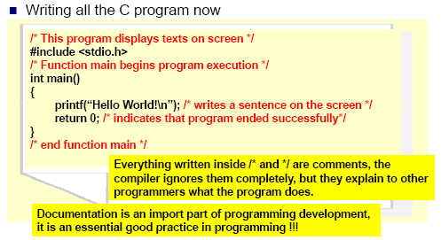
FIRST PROGRAM IN C
Slide <number>

Slide 75
EXECUTING A PROGRAM
Does the computer understand the C language?
  ‘C’ is a high level computer language
  A computer only understands patterns of 0s and 1s
‘C’ allows you to write a computer program using statements that are much easier for you to understand than 0s and 1s
Slide <number>

Slide 76
THANKS
Slide <number>

